Slide 1


Mail2Cloud Case Study
Crescent Electric Supply Company
mxHero Solves for Large Emails &
Drives Cloud Adoption
Copyright 2016, mxHero Inc.
March 8, 2016
Notes:
Now that you have some background as to how Mail2Cloud Fusion works, it’s my immense pleasure to introduce Box’s and mxHero’s joint customer, Dennis Hill, from the leading Electrical Supply Company, Crescent Electric.
Dennis came to us more than a year ago with a serious problem around email attachments.
Dennis, a big ”thank you” for joining us in this webinar. Could you tell us a little about yourself, Crescent and then take the reigns and guide us through the challenges you faced and how Box and mxHero solved not only what you set out to solve but even some of the collateral benefits of making attachments part of Box and not Email.

Slide 2
Preface
The following three slides were presented at a Box & mxHero sponsored webinar by Dennis Hill, IT Manager of Crescent Electric Supply Company on February 25, 2016. It provides an overview of significant cost benefits derived from mxHero’s Mail2Cloud Fusion product suite.
This presentation contains animations. The comment section provides additional contextual content.
To view the original Webinar recording access the following link:
Box + mxHero Joint Webinar with Guest Crescent Electric
(http://goo.gl/uP0kcC)

Slide 3








Mail Flow
Customer
Mail Filter
Sends a 10MB
Email to 2
Employees
Replicated Exchange
Internet
Email
Archive
Corporate
CRM Tool
Employee 2
Branch
110MB of data has been
transferred and stored
Employee 1
Employee 2
Source: Dennis Hill, Crescent Electric
Notes:
Legend: rotating red “No” symbol represent virus scanning.
Email is replicating across:
Redundant servers
Employee devices
Collateral systems, like CRMs
Email archiving systems
Results in a significant multiplier in the infrastructure needed to deal with the attachment data.
Some companies also have local user backups in the form of Outlook PST files – which would further increase storage requirements.

Slide 4
Email Attachment Example
An email was sent to everyone in the company utilizing the mxHero and Box solution.
  The email would have been 2Mb if the PDF was attached. This would have turned into 14GB or $140 in disk storage.
  By using mxHero and Box for this email, 2MB was stored at Box and a 10K email was sent to the 1900 employees utilizing 80Mb or $0.80
Email Stats:
    1900 Employees
    847 Previews – 44.6%
    114 Downloads – 6%
Source: Dennis Hill, Crescent Electric

Slide 5


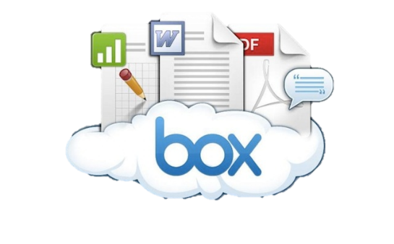
mxHero
Mail Flow
.01MB Email
Customer
Sends a 10MB
Email to 2
Employees
Replicated Exchange
Email
Archive
Internet
Mail Filter
CRM Tool
Corporate
Employee 2
10MB Attachment
Branch
.11MB of data has been
transferred and stored
Employee 1
Employee 2
Source: Dennis Hill, Crescent Electric
Notes:
Impact of Mail2Cloud’s automatic replacement of attachments with cloud storage links on the prior example.

Slide 6
Cost Savings when moving email attachments to Box
Email Usage Stats - Corporate User / Day*
Emails w/ Attachments: 64
Ave. Attachment Size: 530kb
Attachments / Month: 733mb
Crescent Electric Case
Replication (55mb/10mb): 5.5x
Storage Cost: $0.01mb
mxHero + Box Savings
$40.33 user / month
Company Monthly Savings - estimates
Employees | Storage Savings | Net MxHero
100 | $4,033 | $3,733
500 | $20,166 | $18,666
1,000 | $40,332 | $37,832
2,000 | $80,664 | $76,164
10,000 | $403,318 | $383,318
No Replication
$733
$3,667
$7,333
$14,666
$73,330
* Source: Estimates for 2016 based on average trend from Radicati ”Email Statistics Report 2009-2013”
Notes:
Crescent limits user mailboxes. Moving attachments to Box helped reduce mailbox quota issues.
To better understand the wider implications in the market, we matched Dennis’ observations with available stats around corporate email usage.
$40 / user / month which the organization will save by moving email attachments to Box.
Mapping this out to organizations of different sizes the implications are impressive.
The 5.5 multiple will vary from organization to organization, but even an extreme situation in which attachments never leave a single storage repository, which unrealistically implies never used outside of the email system itself (meaning, never synced to devices, never downloaded to local computers), there are savings.

Slide 7





Mail2Cloud Fusion Additional Benefits
Higher Network Performance
Order of magnitude email bandwidth reduction means faster response times for mobile and remote employees.
Attachments transit network in original size – avoiding email encoding file size inflation of +36%.
Improved Collaboration
Cloud storage preview links provide attachment visibility from every device for 140+ file types by Box.
Costs reduced as users no longer need be provisioned with software to preview attachments (ex. AI, CAD, DICOM, etc.)
Copyright 2016 – mxHero Inc.
Augmented Email Capabilities
Email size limitations mitigated. Users can send/receive 500Mb+ emails.*
Detailed geographic tracking of all attachment deliveries.
Leverages Box workflow capabilities across all attachment traffic.
Greater Security
Email attachments no longer exposed in email.
Attachment link security can be administratively set to expire in X days, require authentication or allow preview only (i.e. no download).
More information contact: sales@mxhero.com
* Email server limits govern sending size. Gmail - 25Mb, Office 365 - 150Mb. Exchange configurable.

Slide 8
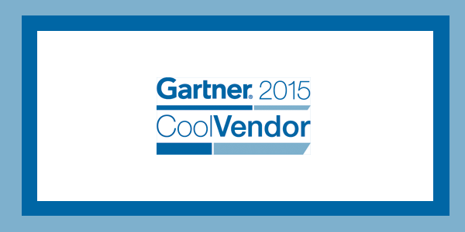



Thank You
alex@mxhero.com
juan@mxhero.com
Gartner does not endorse any vendor, product or service depicted in its research publications, and does not advise technology users to select only those vendors with the highest ratings or other designation. Gartner research publications consist of the opinions of Gartner's research organization and should not be construed as statements of fact. Gartner disclaims all warranties, expressed or implied, with respect to this research, including any warranties of merchantability or fitness for a particular purpose.
“… cool because it combines traditional email applications with modern cloud storage …”
- Gartner
“It’s like Mission Impossible for email”
“Mail2Cloud seems to be an upgrade in every sense!”
“mxHero solves some serious problems!”
Notes:
Thank you Box for the opportunity of this Webinar.
Dennis Hill from Crescent Electric
And you for taking the time to attend.

